Slide 1


IST 707 • PROJECT PROGRESS
Can Economic Conditions Explain Olympic Success?
Predicting national medal outcomes beyond GDP & population using World Development Indicators.
DATA SCOPE
INDICATORS
1960–2016 Olympics
54 WDI Features

Slide 2
PROBLEM DEFINITION
Why Understanding Olympic Economics Matters
The Problem
Key Stakeholders
Target Success
Raw medal counts favor massive nations. National resources and athlete participation vary wildly, creating unequal baselines.
Sports researchers, national Olympic committees, and policymakers seeking fair comparisons of national performance.
A validated prediction benchmark uncovering true economic drivers—not just a repetitive ranking of wealthy states.

Slide 3
PROJECT CONTRIBUTION
Our Unique Methodology & Approach
Beyond Scale Basics
GDP, GDP per capita, and population serve as baselines rather than complete explanations.
Core Research Hypothesis
Broader Economic Context
"Socioeconomic investments in health and education significantly improve predictive accuracy for Olympic success over crude measures of national wealth and population size."
Integrating health spending, education budgets, and growth rates to capture systemic capability.
Fairer Peer Comparisons
Evaluating medals relative to athlete participation within distinct income and population tiers.

Slide 4
DATASET PROVENANCE
Merged Dataset Structure & Scope
13,584
2,715
217
TOTAL OBSERVATIONS
OLYMPIC SUBSET (1960–2016)
OLYMPIC COUNTRY CODES
Source Integration Details
Source File: Pre-merged olympic_economics.csv joining historical IOC results with World Bank WDI series.
Indicator Depth: 205 initial WDI series codes covering 1960–2025 economic history, bridging athlete outcomes with macroeconomic environments.

Slide 5
DATA PREPARATION
Cleaning Without Discarding History
1
2
3
Coverage Threshold
Row Preservation
Modeling Window
Dropped 8 of 62 indicators with <10% observed values, retaining 54 robust WDI metrics.
Maintained all 13,584 rows. Missing economic data is tracked explicitly—never converted to zero.
1,824 observations (1990–2016); 39 indicators have ≤50% missingness across this focus panel.

Slide 6

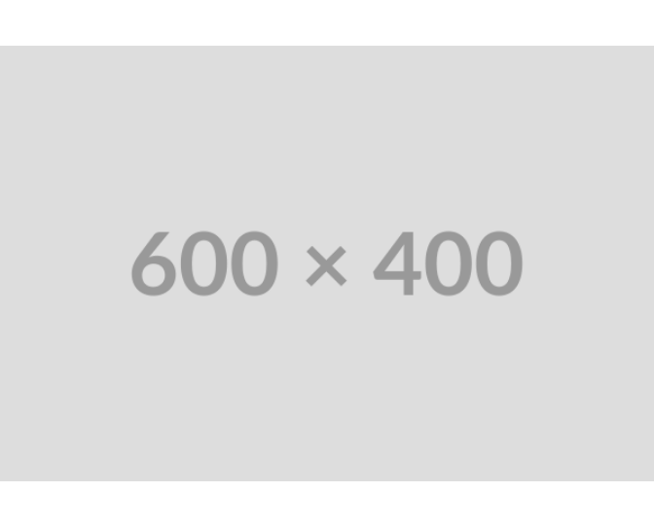
EXPLORATORY DATA ANALYSIS • MISSINGNESS
WDI Indicator Coverage Audit
Missingness Audit
Indicator and country-level missingness reveal which predictors require rigorous imputation.
Modeling Impact
Feature coverage directly shapes imputation strategies and determines trustworthy baseline comparisons.

Slide 7

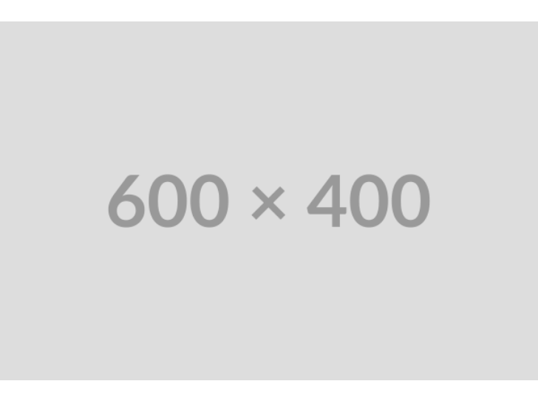
EXPLORATORY DATA ANALYSIS • DISTRIBUTIONS
Skewed Economic Scale Indicators
Log Transformation
GDP, per capita GDP, and population are heavily right-skewed. Log10 scales stabilize variance for modeling.
Health Expenditure
Health spending (% GDP) exhibits normal distribution characteristics without radical log transformation.

Slide 8
EXPLORATORY DATA ANALYSIS • CORRELATIONS
Relationships Among Economic Predictors
Multicollinearity Check
Health & education spending correlate significantly (r = 0.42), while GDP growth shows minimal overlap with scale metrics.
Feature Selection
Mapping collinearity ensures collinear economic factors don't inflate regression variance.

Slide 9
EXPLORATORY DATA ANALYSIS • PARTICIPATION
Athletes Sent vs. Medal Outcomes
CORRELATION STRENGTH
r = 0.887
Spearman ρ = 0.810 (1990+ panel)
Key Takeaway
Delegation size heavily governs medal totals. Economic metrics must demonstrate value beyond team size.

Slide 10
EXPLORATORY DATA ANALYSIS • ECONOMIC PEER GROUPS
Performance Across Economic Bands
Peer Grouping
Crossed population & GDP-per-capita bands reveal efficiency differences in medals per athlete.
Within-Group Variance
Countries with identical scale and wealth exhibit notable performance divergence, supporting our core thesis.

Slide 11
LITERATURE POSITIONING
Research Gap & Benchmark Position
Standard Literature Baseline
Our Research Question
Traditional studies rely almost exclusively on GDP, GDP per capita, and population size as static, deterministic predictors of national medal tallies.
Do expanded World Development Indicators (health, education, investment) provide out-of-sample predictive gains over standard size & wealth models?

Slide 12
MODELING PROGRESS
Model Status & Planned Benchmarks
STAGE 1
STAGE 2 (CURRENT)
STAGE 3
Null / Random Baseline
Scale-Only Model
Expanded WDI Model
Training-set mean and zero-medal baselines paired with a seeded random benchmark.
Fitted values using log GDP and population. Preparing out-of-sample test splits.
Multi-feature model evaluating MAE & RMSE across strict time-based splits.

Slide 13
RISK MANAGEMENT
Challenges Encountered & Solutions
Missing Economic Data
Heavy Skewness
Pruned indicators with <10% coverage; tracked missingness explicitly rather than zero-filling.
Applied Log10 scaling to economic predictors and examined per-athlete metrics.
Temporal Leakage
Model Overfitting
Strictly filtered economic data to pre-Olympic periods and implemented time-aware validation splits.
Preprocessed features using training folds only to preserve authentic out-of-sample scoring.

Slide 14
PROJECT ROADMAP
Roadmap to Final Presentation
01 • PREPARE
02 • BENCHMARK
03 • EXPAND
04 • EXPLAIN
Finalize Targets
Fit Baselines
Incorporate WDI
Interpret Results
Establish strict year-based splits and target variables.
Evaluate null and GDP/population models on MAE & RMSE.
Add health and education features; test grouped models.
Extract feature importances and error profiles by group.

Slide 15
DISCUSSION READINESS
Questions & Discussion Focus
Why look beyond GDP?
Preventing Leakage?
Ensuring Fairness?
Wealth captures capacity but omits public investments in human capital and health systems.
Enforcing strict historical temporal splits; preprocessing steps fit strictly on training folds.
Evaluating performance across population tiers and reporting standardized held-out metrics.

Slide 16

Image Sources
https://cdn.vectorstock.com/i/500p/14/49/medal-podium-awards-vector-35021449.jpg
Source: www.vectorstock.com

